Slide 1
SKETCHIFY
A detail Consistent
image to doodle Convertor using
Deep Generative NEtworks
By- Group 2
Prashant Ramnani Satyam Porwal
Kousshik Raj Robin Babu

Slide 2

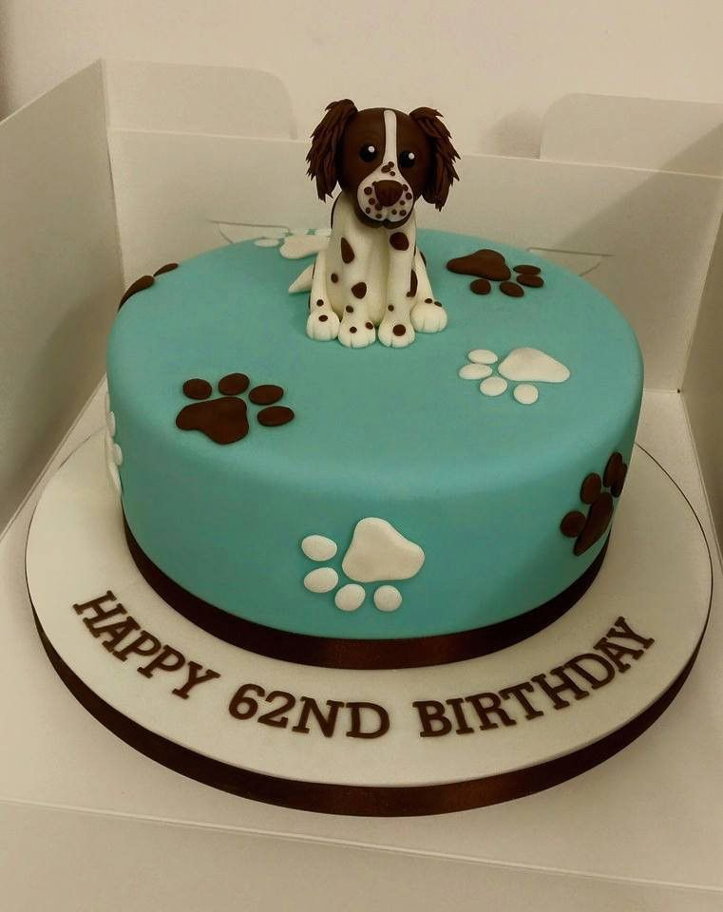
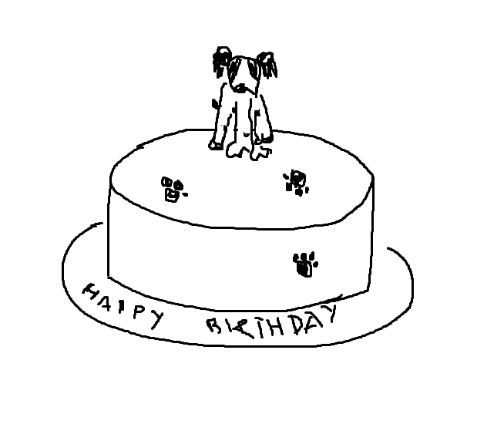
Introduction
Work focuses on converting an image to a sketch/doodle that resembles it without losing major details.
Falls under data abstraction, helps store key information with lesser data.
Helps us analyze the major aspects of the image.

Slide 3
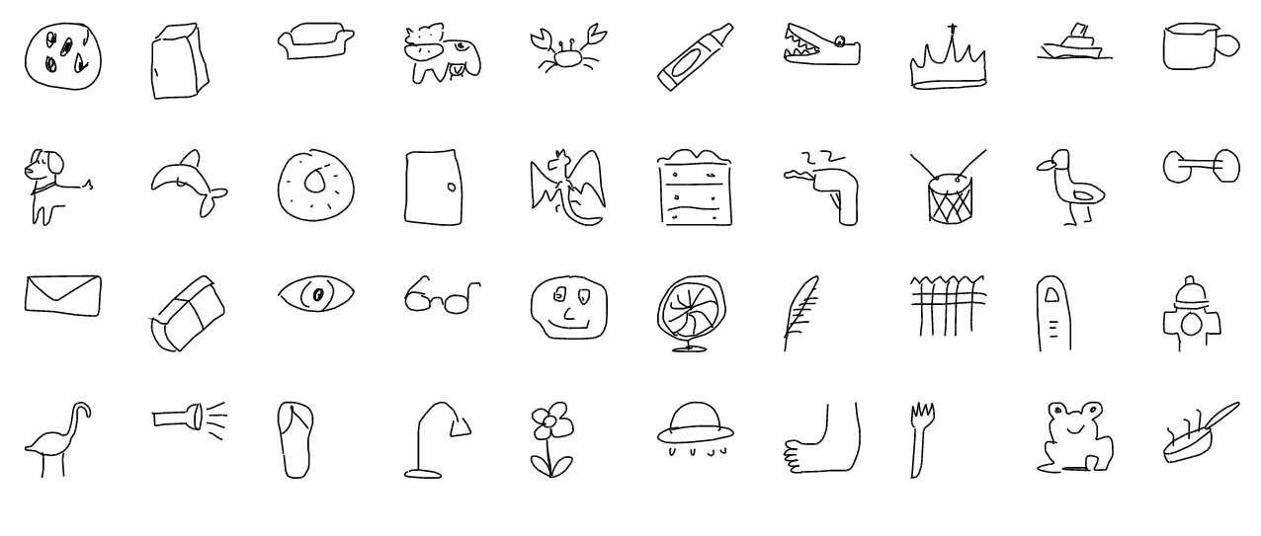
DATASETS

Slide 4
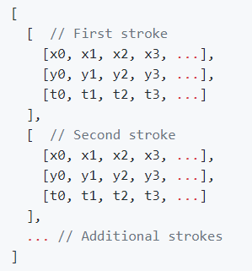
Quick, Draw! Dataset
Collection of 50 million drawing across 345 categories contributed by players of the game "Quick, Draw!" .
Drawing are captured as timestamped vectors, including other metadata.
The format of the drawing data array
The dataset is available on Google Cloud storage segregated by category.

Slide 5
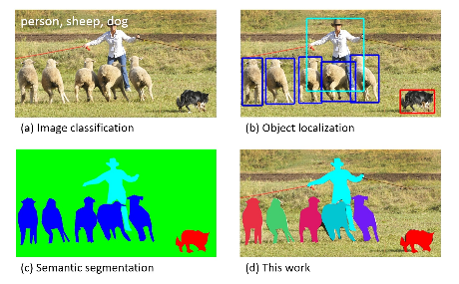
Common objects in Context (COCO)
COCO is a large-scale object detection, segmentation, and captioning dataset.
The dataset has 80 object categories and 91 stuff categories.
The version of the dataset used contains images, bounding boxes and their labels. .

Slide 6

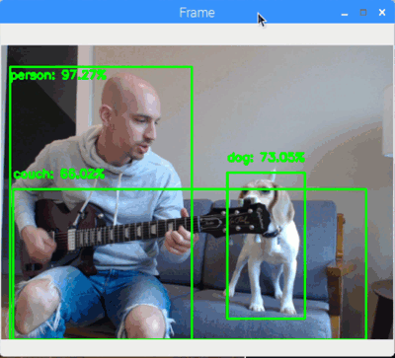
Object Detection
clock
apple
Necessary to detect the various entities in the image
We used TensorFlow Object Detection module based on Faster-RCNN trained over COCO Dataset.
How do we sync the COCO and Quick, Draw! dataset?
What is Faster-RCNN? Why Faster-RCNN?
Output :- Bounding box, label, accuracy

Slide 7
Using Quick, Draw! And CoCo in-sync
COCO and Quick, Draw! sometimes have different labels for same classes.
Even though we used a smaller subset for the project, we need to make a mapping between the two dataset categories.
*NLTK - Natural Language Toolkit
Label from Quick, Draw! dataset
Finding the base word using synset [*NLTK]
Using wordnet similarity to find the most similar word in COCO dataset
Storing the mapping for later use in json

Slide 8
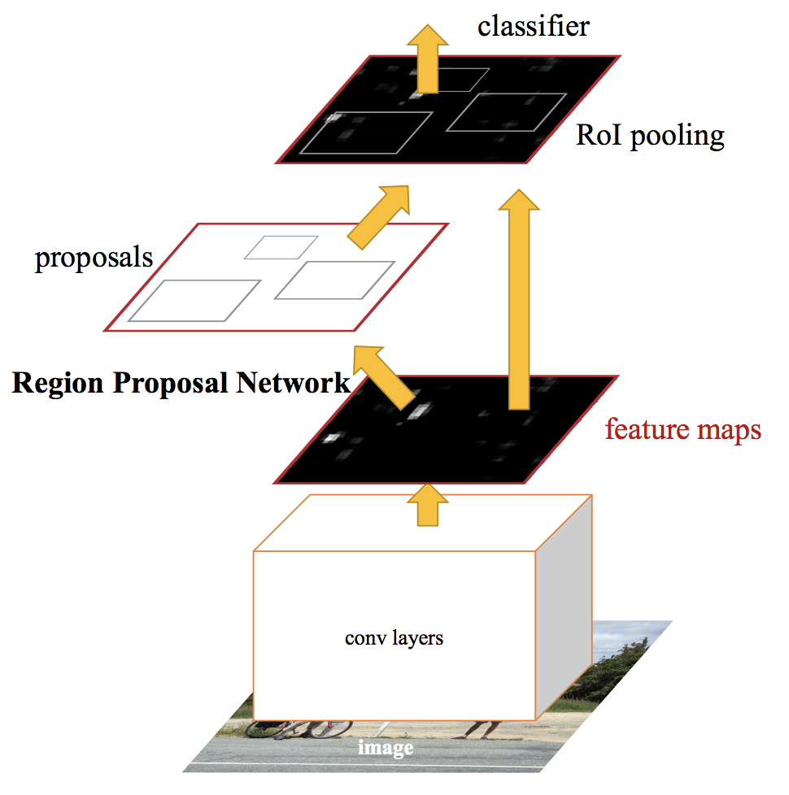
Faster-rcnn
Introduced in 2015 by K He et al
Image is passed and the network generates a convolution feature map.
This feature map is passed to region proposal network which generates anchors.
Classification layer and the regression layers take as input the feature map and the generated anchors

Slide 9
Why Faster-rcnn ?
Faster-RCNN uses Region Proposal Network.
Among other algorithms which work on similar principle, Faster-RCNN has the best observed results.
Why not YOLO? YOLO has its share of struggle detecting small objects within an image.

Slide 10

SKETCH - RNN A Generative Model for Vector Drawings

Slide 11
Overview
Motivation
Variational Auto-Encoder
Architecture
Loss
Function
Abstract visual communication is a key part of how people convey their ideas to others.
The simple drawings drawn may not resemble reality as compared to a photograph but it teaches us how people represent and reconstruct images of world around them.

Slide 12
Motivation
Drawize
Quick, Draw!
Sketch-Rnn
During the lockdown, Drawize has become a popular game for people to enjoy and socialize.
The objective of the game is for others to guess the drawing made by another person
Since the most important part of any project is to find the dataset.
Quick, Draw! is a popular dataset publicly available, even in pre-processed format.
We wanted to refine the drawing already present in the dataset, more inclined towards the image given as input, creating a sense of uniqueness to the drawing hence generated.

Slide 13
Motivation
The image shows the original photo and a human drawn sketch for the same.
The sketch shows that a human brain tries to capture major details like the dog, the cake, the text, small dog paws on the cake decoration.
Our objective is to generate a model that can recreate as many details as possible.

Slide 14
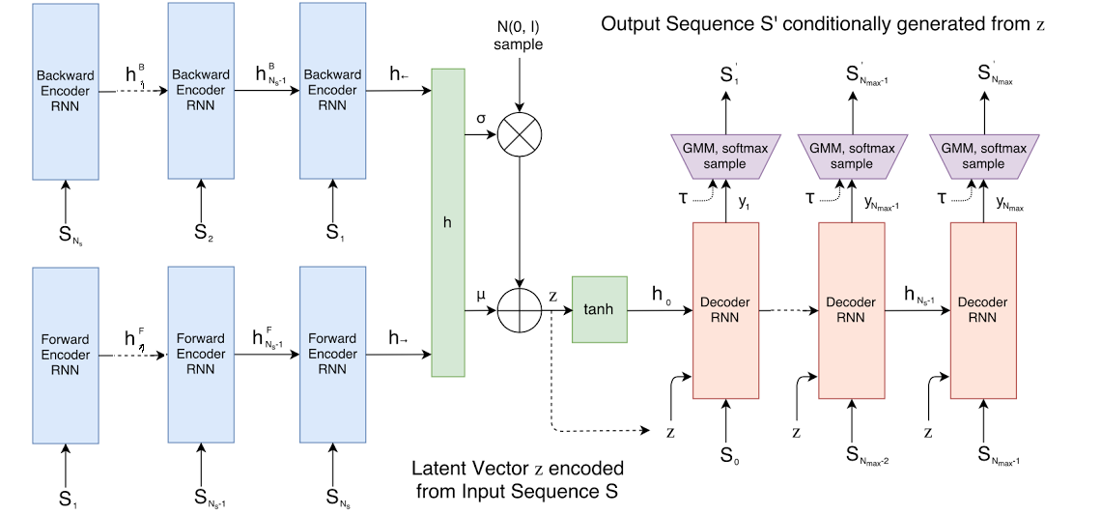
Architecture
Sketch-RNN is based on the idea of Generative Recurrent Neural Network capable of producing sketches of common object.
The model employs a sequence-to-sequence (seq2seq) autoencoder framework.

Slide 15
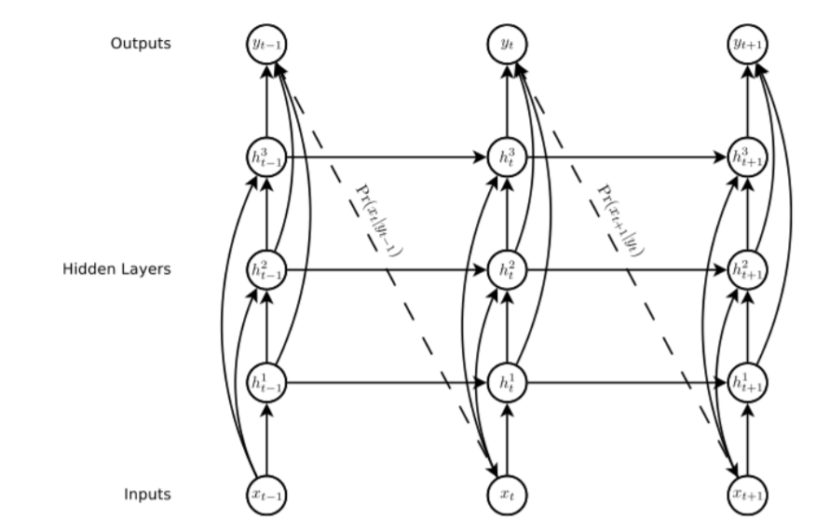
Recurrent neural network
Class of neural network that allow previous outputs to be used as input while having hidden states.
For our model, we used Long-Short Term Memory (LSTM) as encoder RNN and Hyper LSTM as decoder RNN.

Slide 16
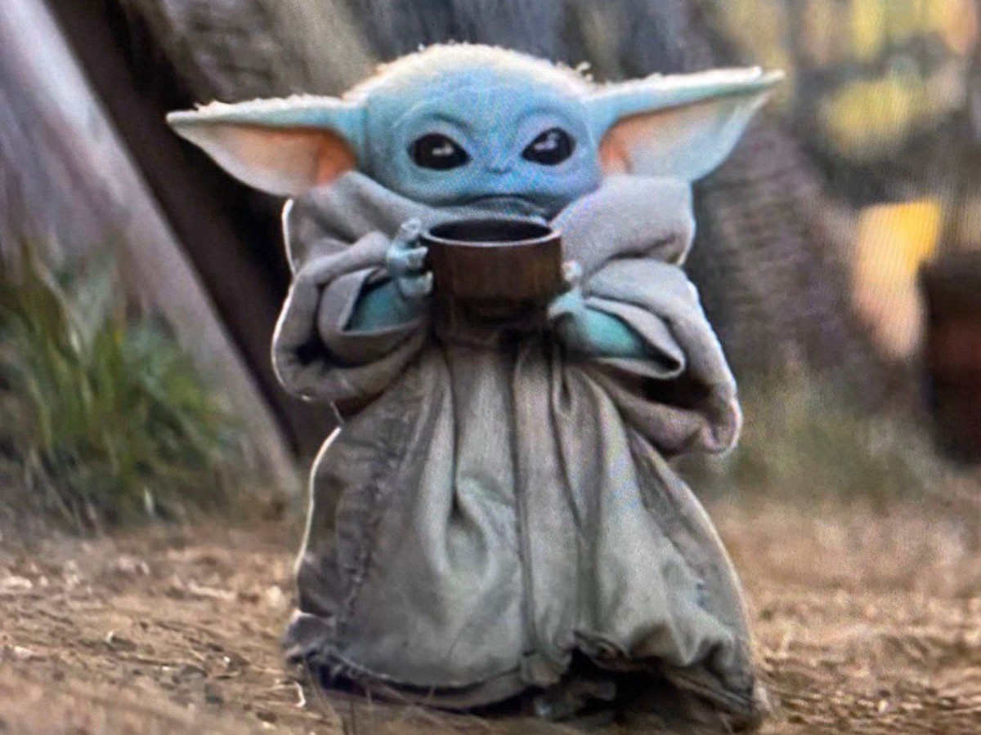
AutoEncoders
Encoder Network
Bottle neck
Decoder Network

Slide 17
AutoEncoders
Encoder Network
Bottle neck
Decoder Network
Reconstruction Loss

Slide 18
Variational AutoEncoders
Mean Vector
Encoder Network
Decoder Network
Latent vector
SD Vector
N(0,1)

Slide 19
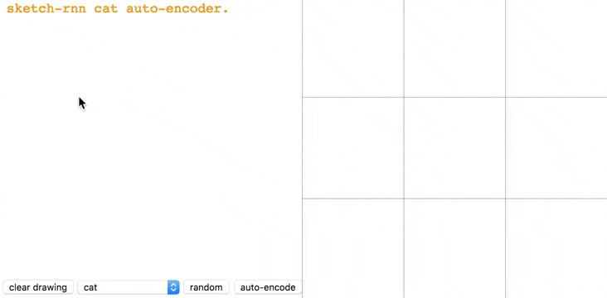
Variational AutoEncoder (VAE)
The encoder used is a bidirectional RNN which takes sketch as input and outputs a latent vector.
Sketch sequence S and the same sketch sequence in reverse S_{reverse} are fed into two encoding RNNs, making up the bidirectional RNN hidden states h_{->} and h_{<-}.

Slide 20
Variational AutoEncoder (VAE)
The decoder used is an auto-regressive RNN that samples output sketches conditional on given latent vector.
HyperLSTM was used because of its ability to spontaneously augment its own weights to adapt to many different regimes in a large diverse dataset.

Slide 21
LoSS FUNCTION
RNN model loss function is based on the approach of Variational Autoencoder.
The loss function is sum of two parts:
Reconstruction Loss ( L_{R} )
Kullback-Leibler Divergence loss ( L_{KL} )
Reconstruction Loss (L_{R}):
It maximizes the log-likelihood of generate probability distribution to explain the training data S.
Kullback–Leibler divergence (also called relative entropy) is a measure of how one probability distribution is different from a second.
LOSS = L_{R} + w_{KL}L_{KL}

Slide 22
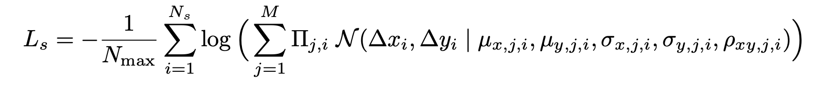
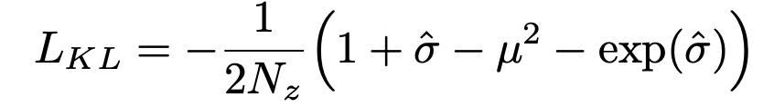
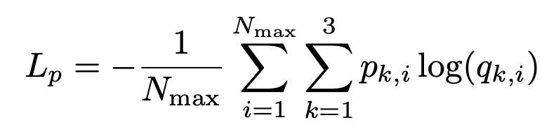
Kullback-Leibler Divergence loss ( L_{KL} )
Reconstruction Loss ( L_{R} )
The loss function is generated using the probability distribution function and the training data S.
L_{R} composes of :- Offset Loss ( L_{S} )
N_{max} is the total sequence length
Pen State loss ( L_{P} )
p1 - pen is being used p2 - pen is in the air
p3 - drawing complete
Measures the difference between the distribution of our latent vector z, to that of an IID Gaussian vector with zero mean and unit variance
This methodology of
loss calculation is robust and allows the model to easily learn when it should stop drawing unlike method where importance weighting was assigned on just p1, p2, p3.

Slide 23
Bringing
it all
together
Object Detection
Sketch-RNN
Replacement
Outputs Bounding Boxes and Labels of Objects detected
The initial sketch is improved by the generative RNN
Replacing the bounding boxes with their corresponding sketches

Slide 24
The Pipeline
01
02
05
03
04
Object detection outputs Bounding Boxes and Labels of objects detected
Using generated mapping find the corresponding labels of object in the Quick, Draw! dataset
Using the mean position of bounding box as location for generated sketch, final image is generated
For each bounding box a random sketch is taken from Quick, Draw! dataset
Passing this through Sketch-RNN, a better sketch is generated

Slide 25
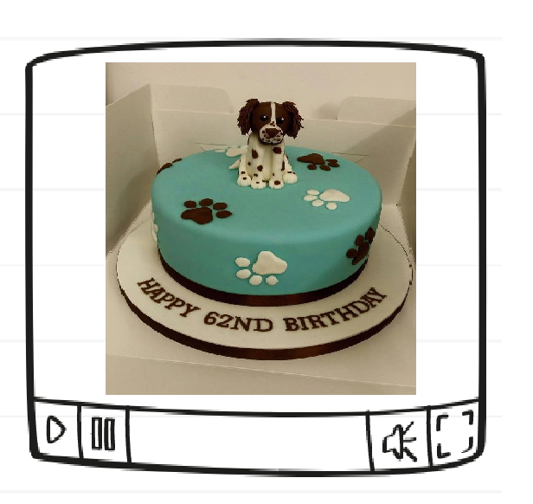
Input Image

Slide 26
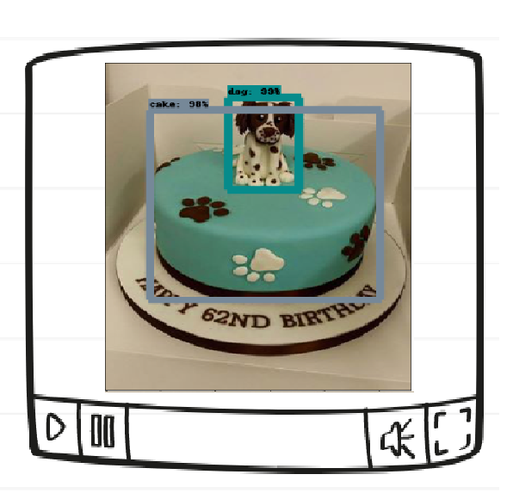
Objection Detection Shows that dog and cake has been detected. Other details have not been.

Slide 27
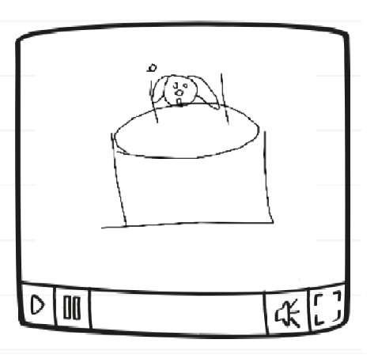
Result without Sketch-RNN Generated by replacing objects with a drawing from Quick, Draw! dataset.

Slide 28
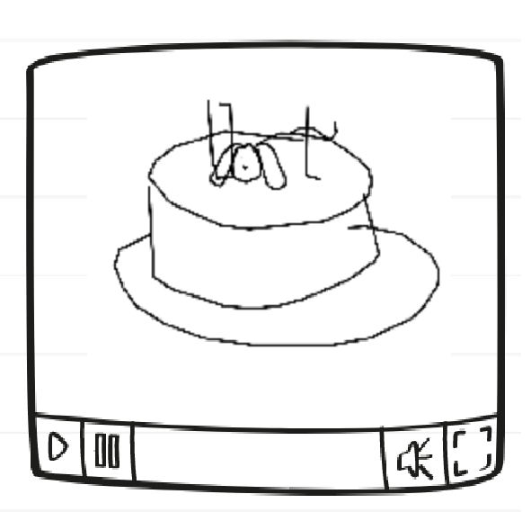
Result using Sketch-RNN
Result generated using Sketch-RNN on individual objects
A positive comparison can be made to the human sketch. The results here show that model has tried to replicate a lot of the details, similar to the hand-drawn sketch.

Slide 29
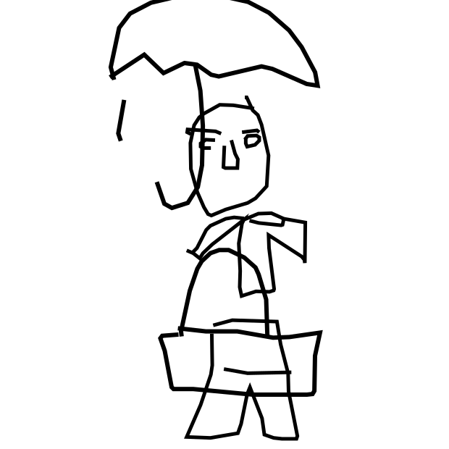
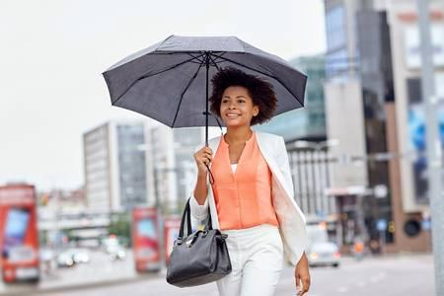
RESULTS
The result of the lady has been generated using the Sketch-RNN module.
The result shows that the model has learned complex object like human and tried to recreate as many objects in the image.

Slide 30
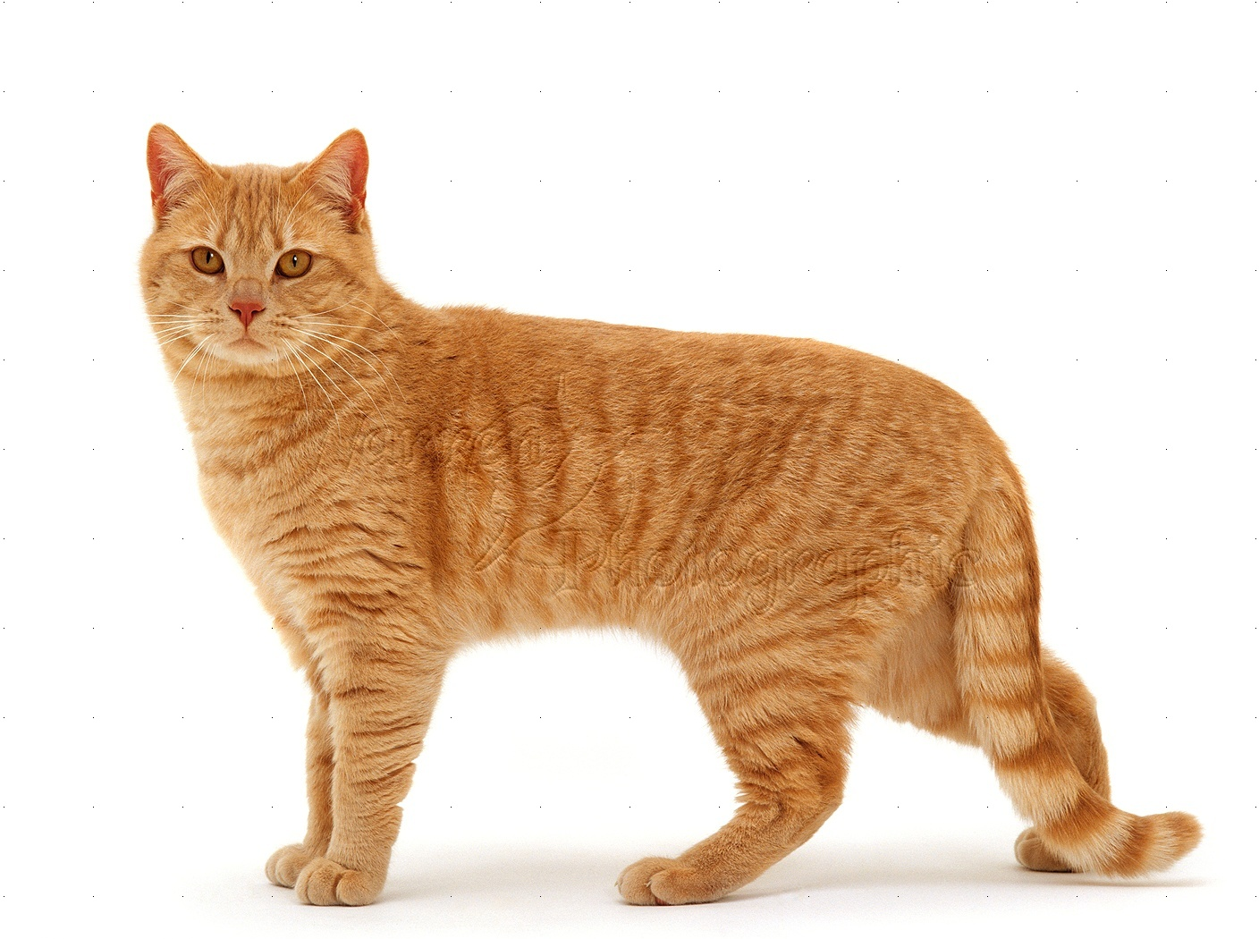
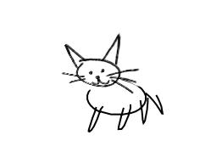
RESULTS
The result of the cat has been generated using manually running multiple iteration of the Sketch-RNN module over the sketch generated until a satisfactory result is generated.

Slide 31
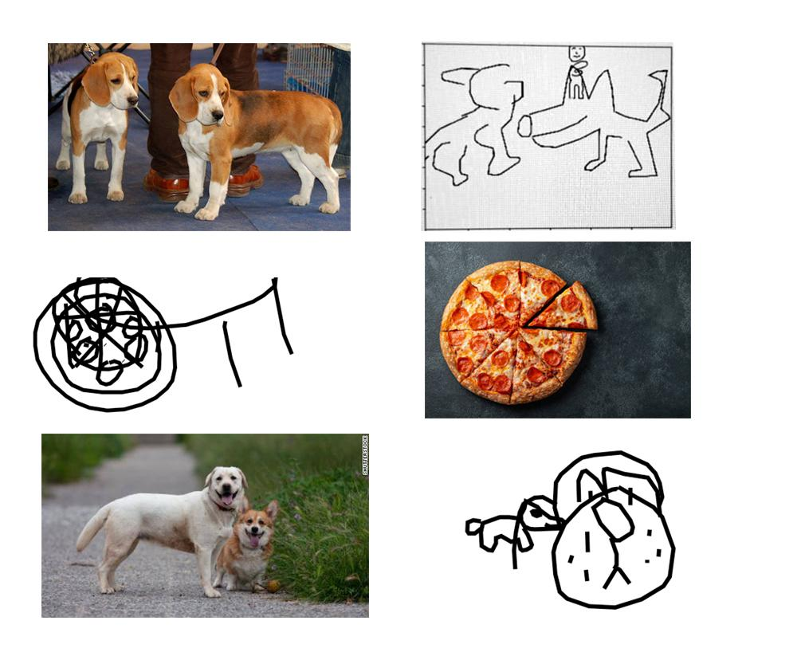
PROBLEMS
These are also results which were obtained using the same model.
The model did not produce satisfactory results in these cases.
The model suffered to learn objects like pizza and dogs to produce sufficiently good results.

Slide 32
PROBLEM
SOLUTION
PROBLEM
SOLUTION
Problems Faced And Possible Solutions
Object Detection only identifies what category an object belongs to, hence no data about it’s orientation is captured.
Not able to generate/show dependence/interaction between multiple objects present in the image
This can be improved by using latent vector spaces of the two models and using it to train interaction between the two.
Other computer vision techniques like canny, image abstraction can be used to gather more details.

Slide 33
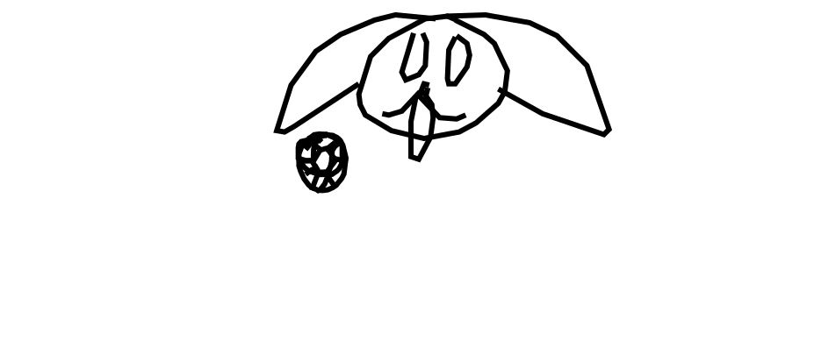
THANKS!

